Slide 1
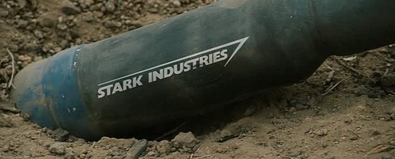
WW1 Weapons Advertisement
You will be assigned a partner
You will randomly choose an advancement
You will create a sales flyer or promotion (via PPT) convincing the US government that they should purchase from you, a defense contractor/weapons manufacturer, your new and innovative armament!
2-3 pictures of it (It is an advertisement….make it visual and informative)
What is it and what does it do?
What are the advantages?
Create a SLOGAN
Use slang from the era
Contact info
Complete all of the requirements on 1 slide!
30 POINTS!

